Slide 1
Lab 4 - Conditional VAE for Video Prediction
2023 Summer
Zong-lin Gao
Aug 8, 2023
Notes:
‹#›

Slide 2
Outline
Introduction
Lab details
Requirements
Others
Notes:
‹#›

Slide 3
Introduction

Slide 4
Important Date
E3 upload deadline: 2023/8/17 12:00
Demo 2023/8/17 start at 13:20
Upload format LAB4_{student_ID}_{your_name}.zip
- LAB4/
- report.pdf

Slide 5
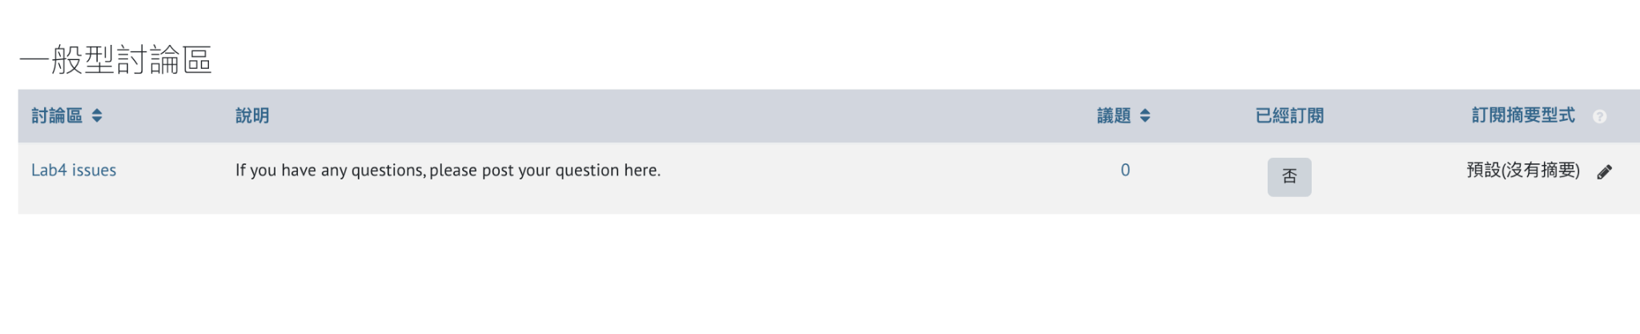
General Forums
If you got any questions, please post it in general forums
other students might have the same questions
TAs will try their best to answer you in time

Slide 6
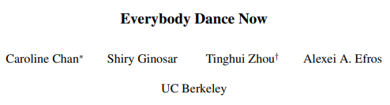
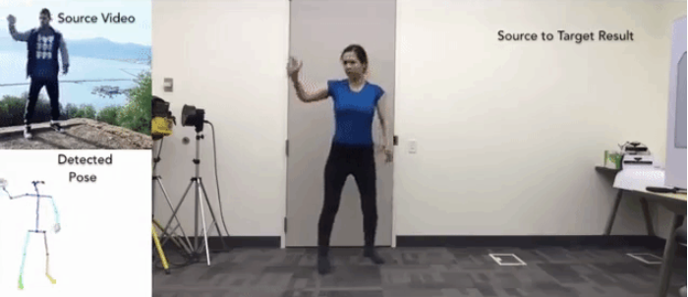
Introduction - Theme (Prior work)
refer to https://github.com/carolineec/EverybodyDanceNow

Slide 7
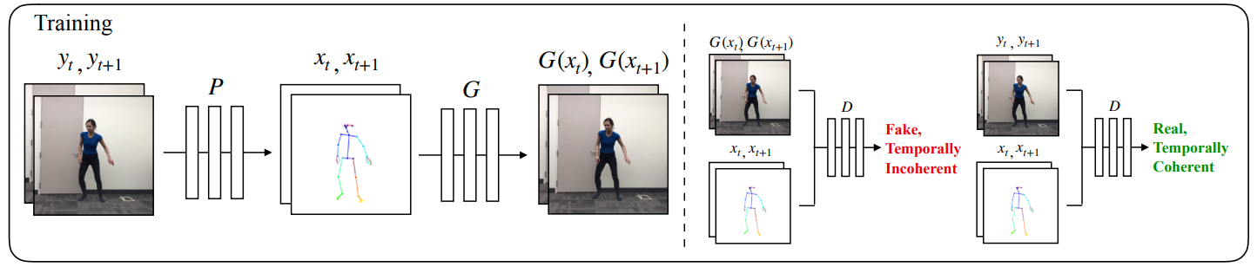
Introduction - Theme (Prior work)
Use pre-trained pose estimation network to generate pose images
Predict the following video frame with GAN-based structure
Generate the prediction by taking pose as inputs in inference time
refer to https://github.com/carolineec/EverybodyDanceNow

Slide 8
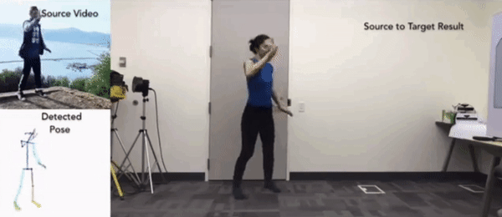
Introduction - Theme (Prior work)
Inference the output in frame by frames
Generate the video output by concatenate a sequence of output images
refer to https://github.com/carolineec/EverybodyDanceNow

Slide 9
Lab details

Slide 10
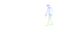
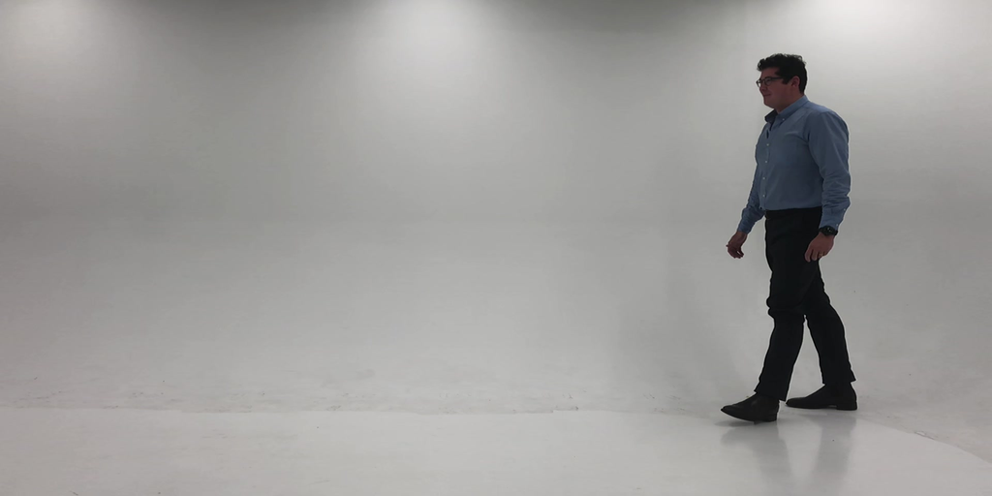
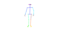
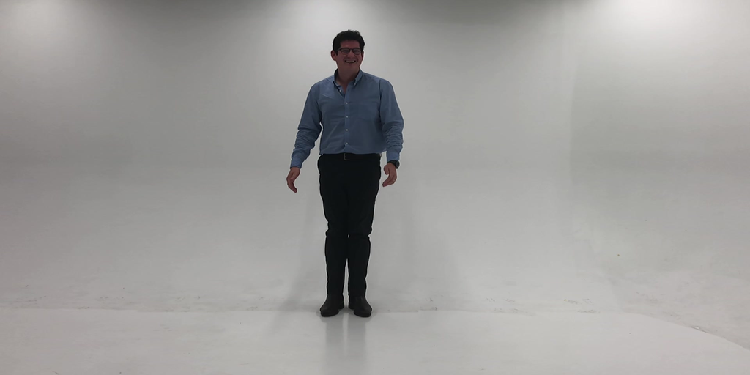


Lab Objective
In this Lab, you need to implement video prediction by VAE method
Pose Video sequence
one Initial image
To generate predicted video sequence
Pose video
First image
Pose video
First image
Pred video
Ground truth
Pred video
Ground truth

Slide 11
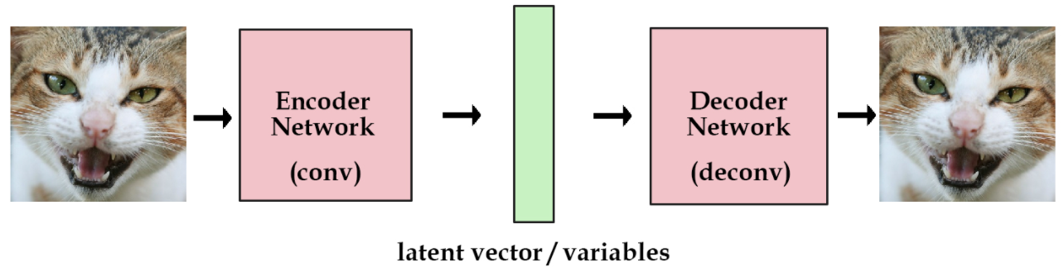
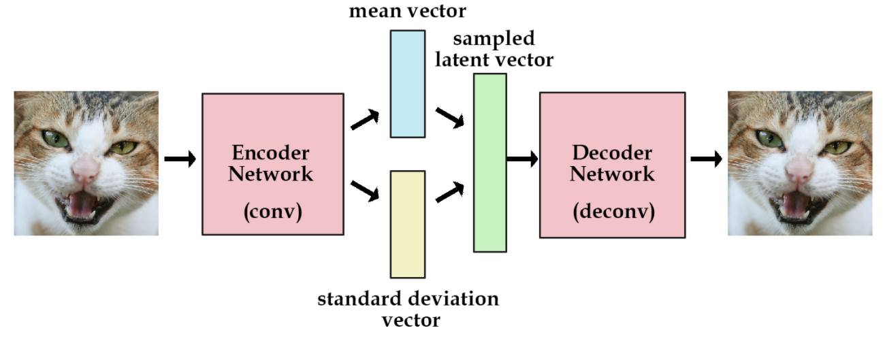
VAE recap
AE
VAE

Slide 12
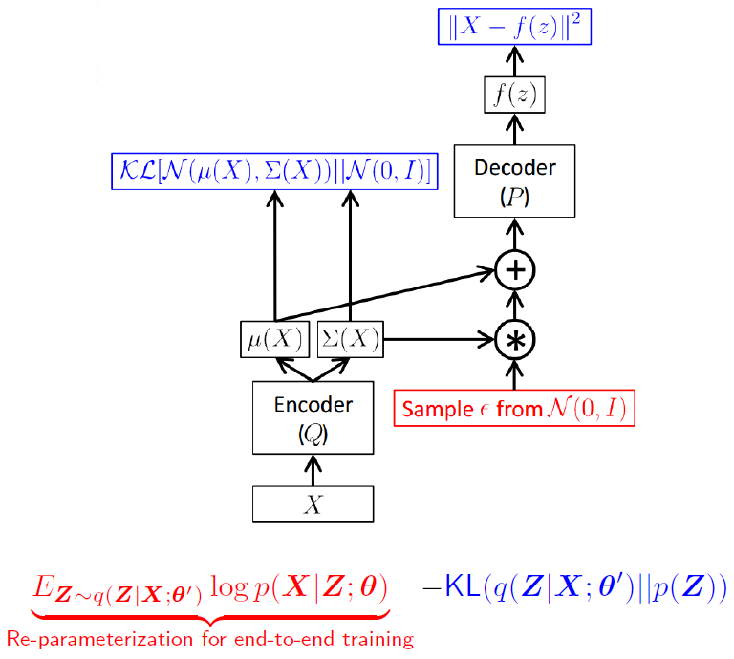
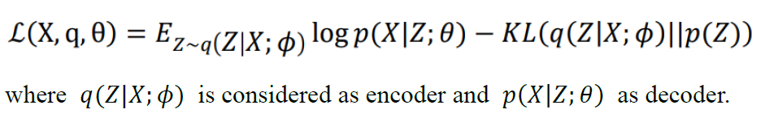
VAE recap - Reparameterization tricks
Output should be seem as log variance rather than simply variance

Slide 13
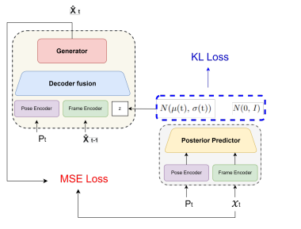
LAB Description - Training
Generate posterior by posterior predictor
Take the following info as input to Decoder Fusion
Pose image
Last frame
Sample Z from posterior predictor
Generate the final output by Generator
Loss = MES-term + KL-term

Slide 14
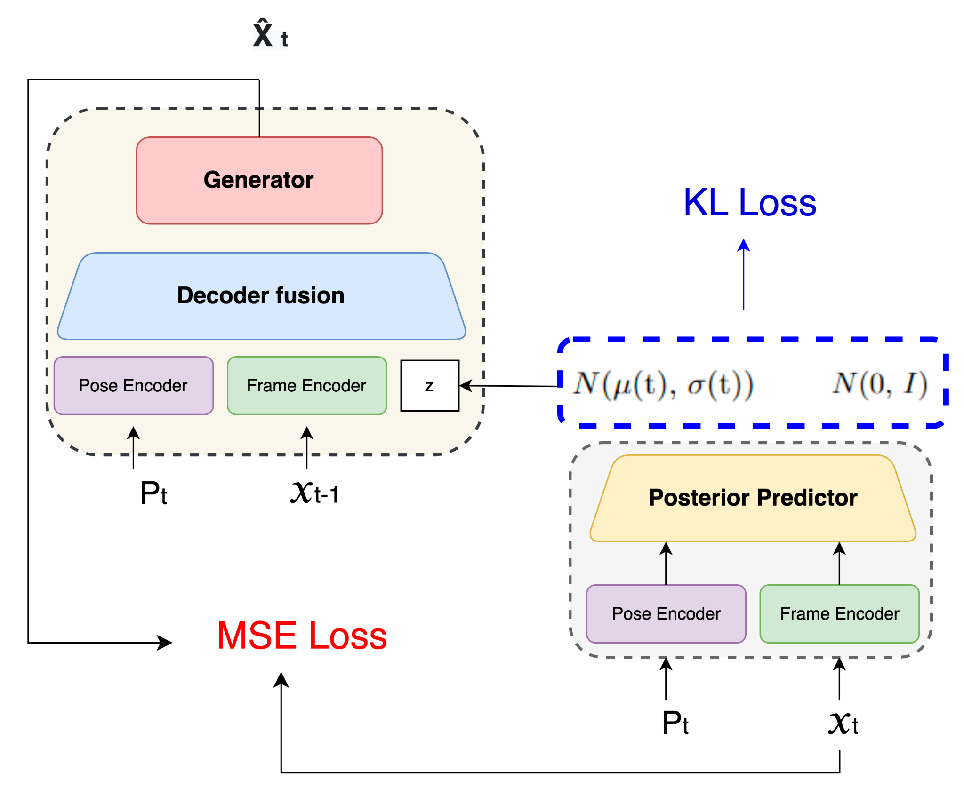
LAB Description - Teacher forcing
Take ground truth frame as input rather than last generated frame
Teacher forcing ratio is set to 0 ~ 1 and
When to use teacher forcing depends on your design

Slide 15
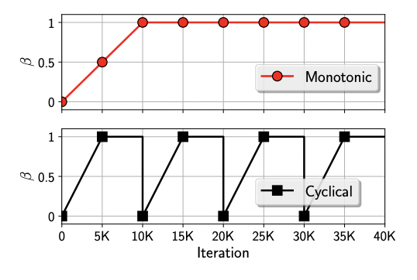
LAB Description - KL annealing
To stable training
Loss = MES-term + KL-term * ɑ
H. Fu, et al., “Cyclical Annealing Schedule: A Simple Approach to Mitigating KL Vanishing,” NAACL 2019

Slide 16
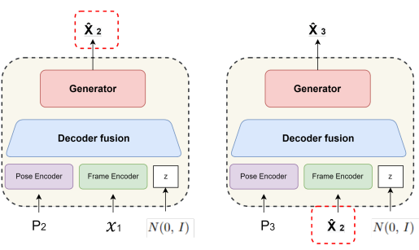
LAB Description -Inference
Generate frame by taking
Pose image
last generated frame
Z sample from prior distribution
Prior distribution can be set by yourself
N(0, I) is recommended

Slide 17
Requirements

Slide 18
Requirements
Training details implementation
Training protocol
Teacher forcing strategy. Teacher forcing ratio range 0 ~ 1
KL annealing strategy
Plot diagram
Plot the loss curve in different kind of setting while training
Plot PSNR per frame while validation your output result
Plot teacher forcing ratio while training

Slide 19
Requirements
Analysis
Compare the loss curve difference in different setting and make your assumption
Make your validation result into gif files (This should be shown in Demo)
Derivation of conditional VAE (see the detail in spec)

Slide 20
Others

Slide 21
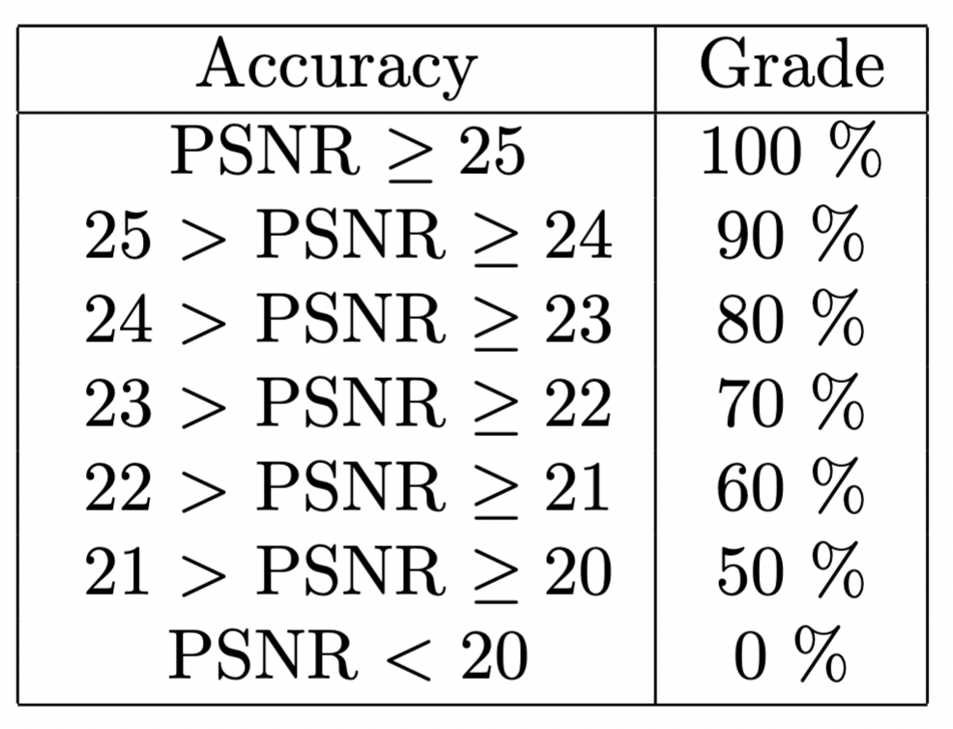
Testing time
6 videos should be generated
Each video sequence contains
one initial frame
630 pose images
You need to take given datas to generate the following 629 future frames

Slide 22
Provided files
Trainer.py
Tester.py
dataloader.py
requirements.txt (python3.9 is recommended)
modules/
Demo_test (testing datas)

Slide 23
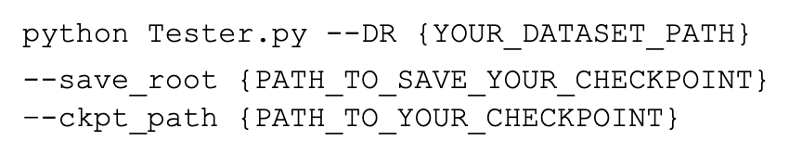
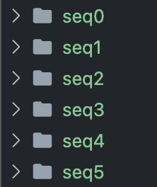
RUN Test
Testing file has been done, simply type the following command
It is OK to modify the files e.g. change module structure. DO NOT change the modules’ name. OR Your testing result may be wrong
6 dir will be created at your {--save_root}

Slide 24
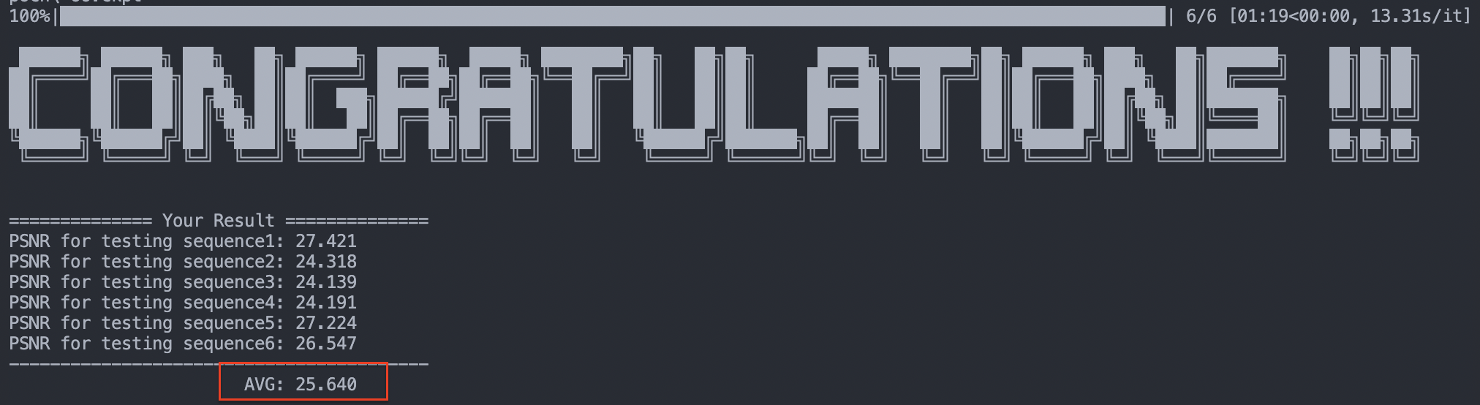
RUN Test
If success, this view should be seen
Value within red box will be taken as your performance score

Slide 25
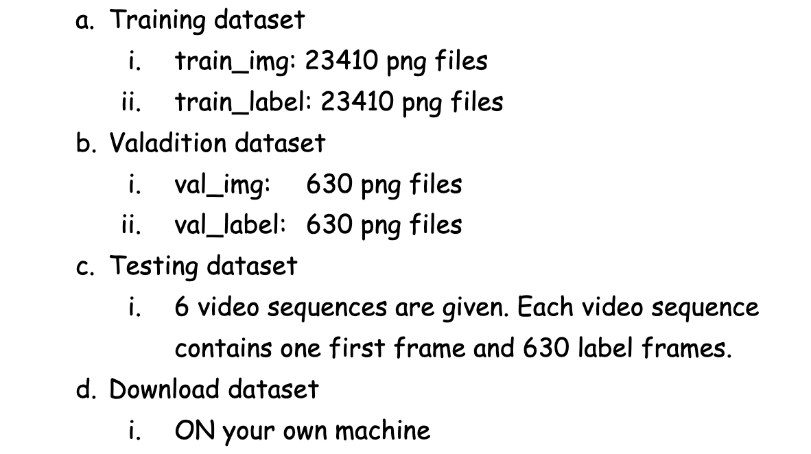
Dataset

Slide 26
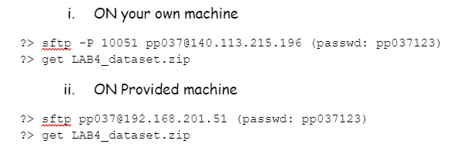
Dataset - Download

Slide 27
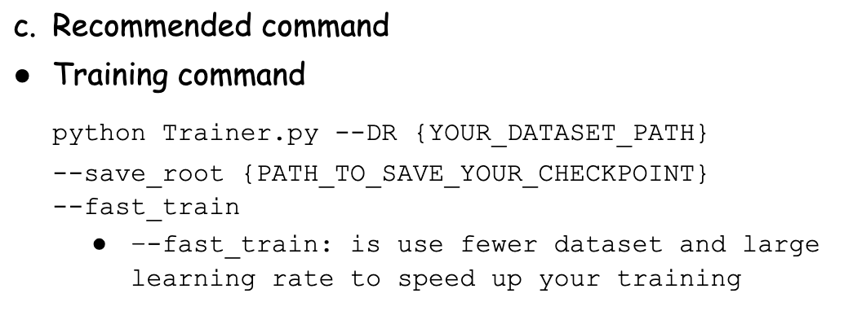
Recommend commands

Slide 28
Reference
[1] C. Chan, et al., “Everybody Dance Now,” ICCV, 2019
[2] E. Denton, et al., “Stochastic Video Generation with a Learned Prior,” ICML, 2018
[3] H. Fu, et al., “Cyclical Annealing Schedule: A Simple Approach to Mitigating KL Vanishing,” NAACL 2019

